Slide 1
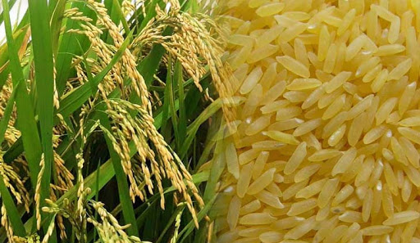
Golden Rice

Slide 2
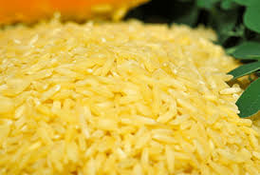
What is Golden Rice ?
Golden rice is a form of rice with biosynthesis of beta-carotene (a form of vitamin A).
Golden rice is produced through genetic engineering.
Beta-carotene gives golden rice its “golden” or “yellow” colouring. White rice, on the other hand, does not contain carotenoids (i.e. beta carotene) and therefore lacks that “golden” colouring.
When we consume golden rice, the beta-carotene either accumulates in our fatty tissues or is transformed into vitamin A.
Golden rice is rich in beta-carotene and also easily processed by your digestive system.
The natural fatty lipids in golden rice aid in the absorption of beta-carotene, even when little or no oil is added to it.
Other benefits of golden rice include: increased energy (which comes from the starch located within the rice) and a low fat content.

Slide 3
Golden rice and Vitamin A
It is important to understand that golden rice is considered a type of genetically modified rice (GMO).
It is a fortified food that is produced to combat a vitamin A deficiency in areas where this vitamin is scarce.
More and more people are being diagnosed with a vitamin A deficiency. In fact, young children are the most vulnerable to vitamin-related deficiencies.
Approximately 1 million children die of a vitamin A deficiency each year. A vitamin A deficiency can severely affect a child’s eyesight; weaken his/her immune system function and increase his/her risk of chronic conditions.
Moreover, in underdeveloped countries, approximately half-a-million people, mostly children, develop blindness, associated with a vitamin A deficiency.
Approximately 50% of those diagnosed with this type of deficiency related blindness die a year or two after becoming blind (Wright, Hinchliffe & Adams, 2005).
To make matters worse, approximately 10 million children suffer from malnutrition every year. In severe cases, the malnutrition turns deadly (Wright, Hinchliffe & Adams, 2005).

Slide 4
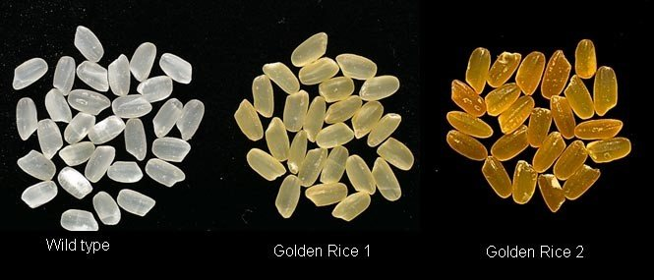
Low levels of vitamin A can negatively affect our immune system and cause serious illnesses and/or death.
In the last few years, an increase in child deaths (under the age of five) has been linked to deficiencies in vitamin A, protein and zinc.
The newest form of golden rice varies from the original strain through the addition of three new beta-carotene genes.
In addition, this newest form of golden rice (invented in 2005) is referred to as Golden Rice 2 because it contains higher levels of beta-carotene then the original golden rice.
Golden rice was originally developed, with the support of environmental activists, to improve, enrich, support and enhance health and well-being and it has accomplished its goals.
The invention of golden rice has lowered the risk of a variety of health conditions and ailments. Golden rice has been tested in the Philippines for over two seasons on two different locations in 2012.
White rice vs Golden Rice

Slide 5
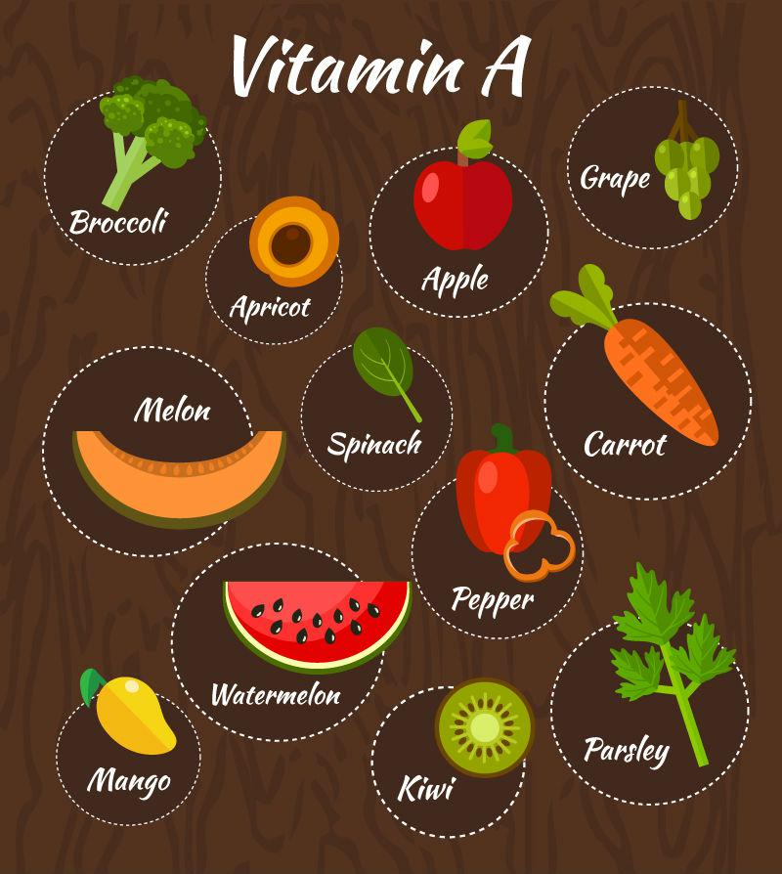
Carotenoids and Vitamin A
Carotenoids, like beta-carotene, are the colourful plant pigments normally found in a variety of fruits and vegetables (carrots, tomatoes, broccoli, cantaloupe, sweet potatoes, etc.).
It is important to note that plants lack the direct form of vitamin A, but do contain beta-carotene, a form of vitamin A.
Our body metabolizes vitamin A when we consume foods rich in beta-carotene.
Vibrant fruits and vegetables, along with meats contain vitamin A.
If we adhere to a poor diet, we have an increased risk of life-threatening medical conditions and diseases associated with a vitamin A deficiency.

Slide 6
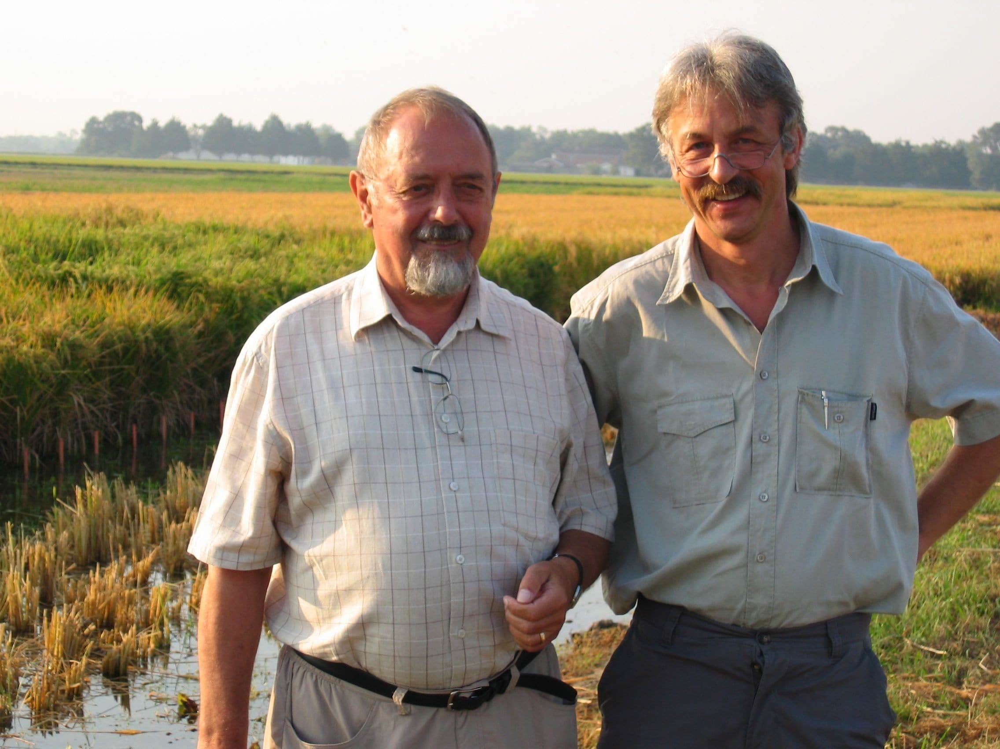
Golden Rice History
Golden rice was invented in 1999 by Peter Beyer, professor at the University of Freiburg, Germany and Ingo Potrykus, professor at the Swiss Federal Institute of Technology at the Institute for Plant Sciences.
Golden rice was originally produced in 1982 as an initiative for the Rockefeller Foundation.
Beyer and Potrykus developed a rather complex biosynthetic crop that could be altered to produce healthier and more abundant grains like rice.
Peter Beyer and Ingo Potrykus

Slide 7
The Science of Golden Rice
Metabolic engineering
Golden Rice technology is based on the simple principle that rice plants possess the whole machinery to synthesise β-carotene, and while this machinery is fully active in leaves, parts of it are turned off in the grain.
By adding only two genes, a plant phytoene synthase (psy) and a bacterial phytoene desaturase (crt I), the pathway is turned back on and β-carotene consequently accumulates in the grain.
Carotenoids and their derivatives include a vast number of molecules and accordingly a great number of enzymes and cofactors.
Only a small number of carotenoids namely those with at least one unsubstituted β-ionone ring, such as β-carotene have provitamin A activity.
Compounds derived from this important pathway include plant hormones, like abscisic acid, the strigolactones and gibberellins.
Tocopherols (vitamin E), chlorophylls and quinones employ the pathway intermediate GGPP as a building block for their synthesis.

Slide 8
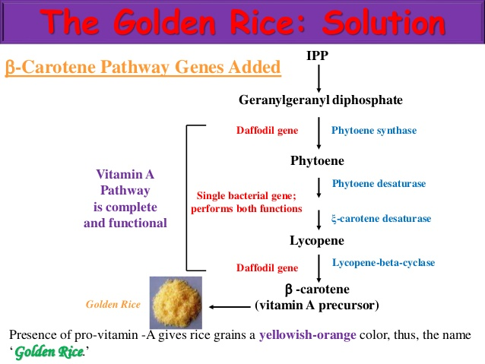
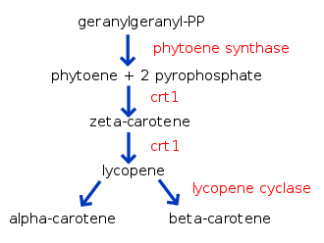

Slide 9
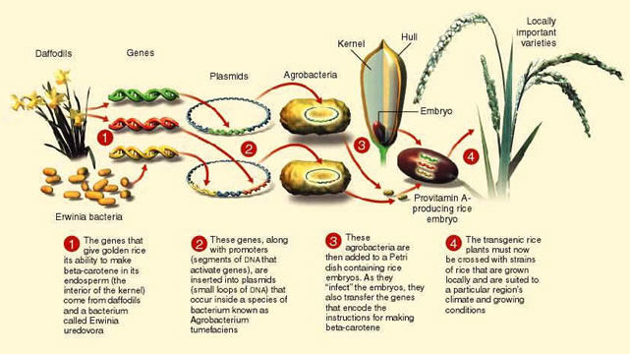

Slide 10
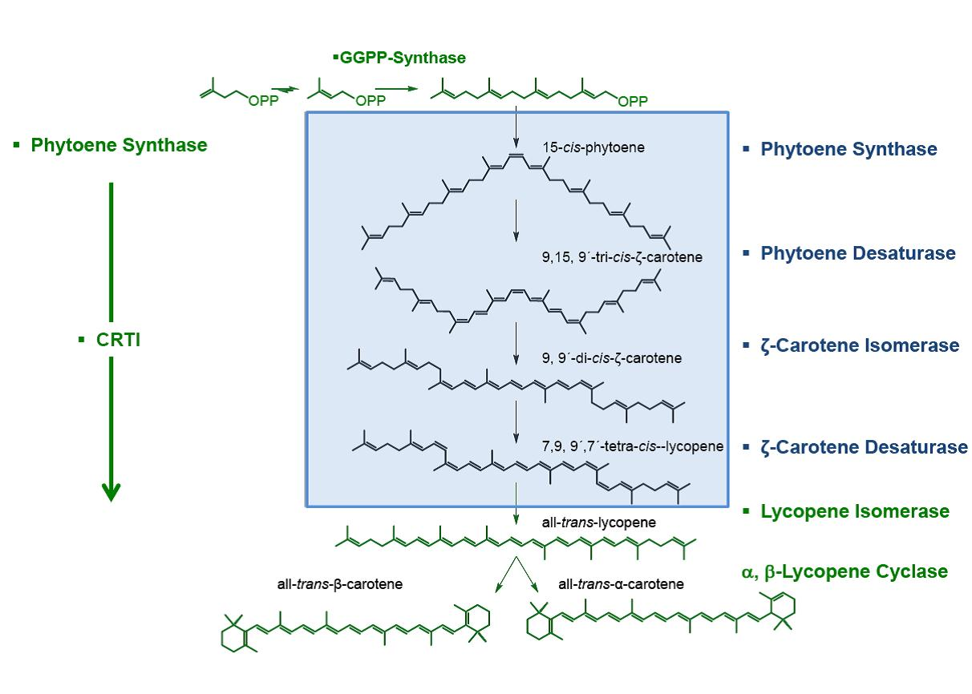
Filling a biosynthetic gap: Pathway elements in green are functional in wild-type rice grains. Thus the GGPP precursor molecule is being synthesized and lycopene can be cyclized. Elements in blue, including the blue box, are effectively absent. Introduction of the enzymes phytoene-synthase and the bacterial desaturase CRTI fills the biosynthetic gap created by the absence of the blue elements.

Slide 11
The underlying science
Early research by 1990’s proved that 2 transgenes required
Phytoene synthase (PSY) an Phytoene desaturase and zeta carotene desaturase (CRT1). Lycopene cylase .
Later studies proved that Lycopene cylase is not required as rice contains this enzyme.
the advantage of the CRTI desaturase lies in the fact that it can perform the entire reaction sequence from phytoene to lycopene on its own, while plants employ two desaturases and two cis-trans isomerases to achieve the same outcome. This reduces the number of transgenes required to only two.

Slide 12
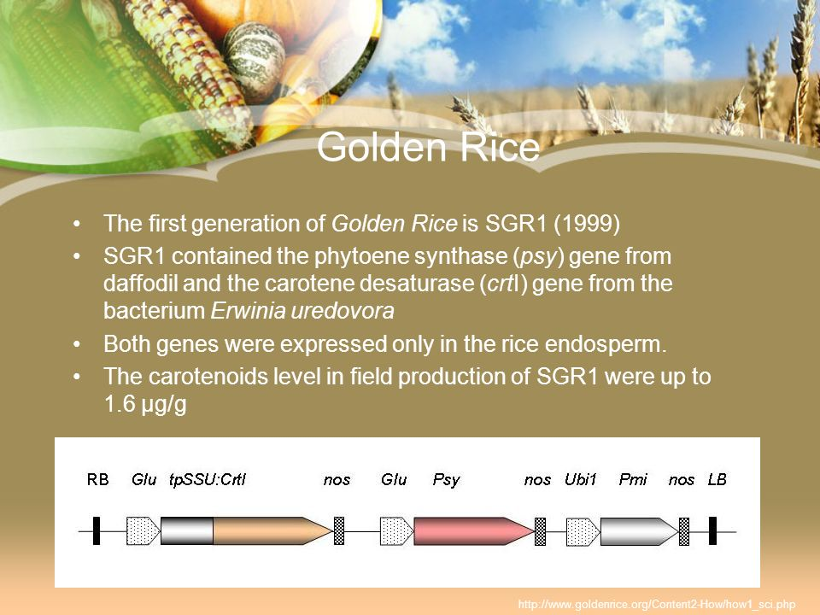

Slide 13
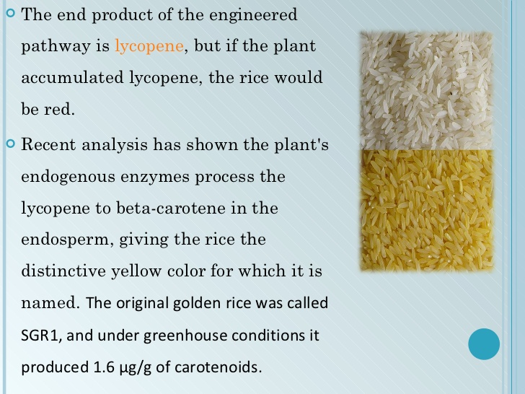

Slide 14
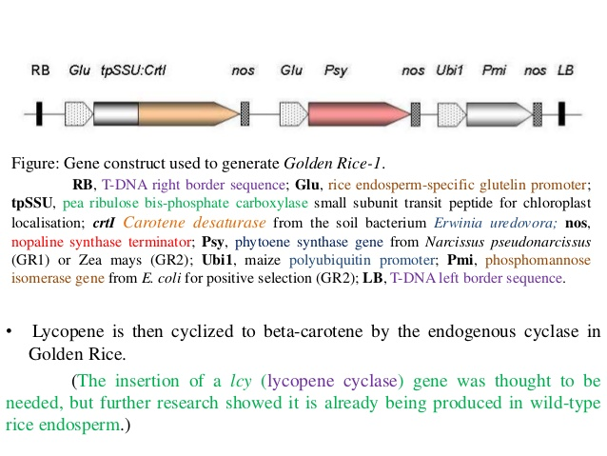

Slide 15
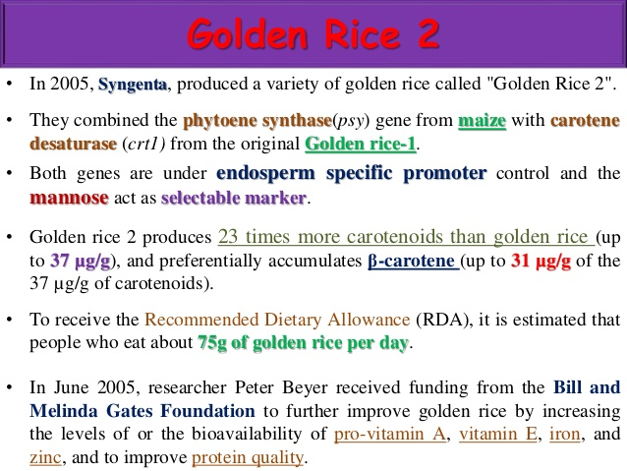

Slide 16
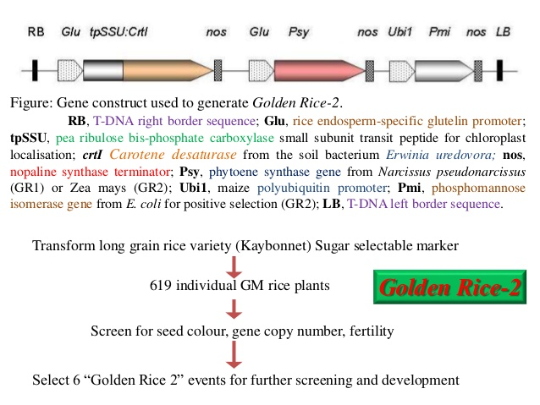

Slide 17
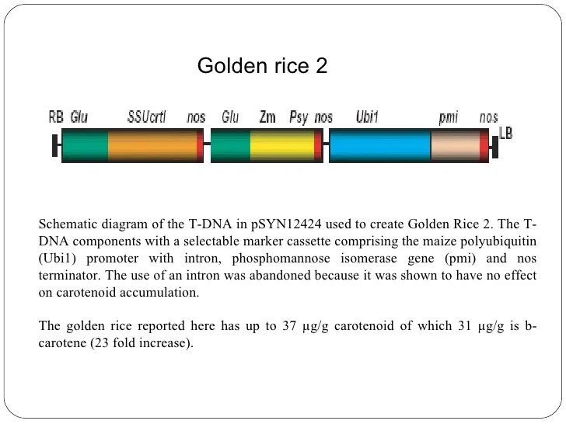

Slide 18
Golden Rice Benefits
Lowers Risk of Blindness, Infections, Cancers and Diseases
Golden rice has the ability to lower your risk of blindness, infections and cancers.
A vitamin A deficiency can increase our risk of vision impairments, age-related macular degeneration and blindness.
It can also worsen infections (measles, HIV, AIDS, chicken pox, etc.), especially in children.
Approximately 125 million children, worldwide, exhibit chronically low levels of vitamin A (Wright, Hinchliffe & Adams, 2005).
The carotenoids found in golden rice can combat adult degenerative diseases.
Other benefits of golden rice include: a lower risk of both a variety of heart diseases and prostate, breast and skin cancers.

Slide 19
Reduces Gastrointestinal Distress
Another one of the benefits of golden rice is that it can reduce gastrointestinal distress.
In fact, it is considered a beneficial food to eat following an episode of diarrhoea, regardless of the cause.
Golden rice behaves like a mild astringent in your gastrointestinal system, which supports easy digestion and restores your intestinal mucus following an episode of gastroenteritis and colitis.

Slide 20
Reduces High Blood Pressure and High Cholesterol
Golden rice is a low-fat and low-sodium food; therefore it is especially beneficial for lowering high blood pressure and cholesterol.
High levels of sodium, a mineral, can lead to fluid accumulation, edema (fluid retention) and a spike in blood volume.
The excess fluid can increase your risk of high blood pressure. In other words, the more sodium you consume, the higher your blood pressure may soar.
Moreover, one of the most valuable benefits of golden rice is that it prevents fiber-related biliary acids from accumulating in your intestines.
Biliary acids found in the liver and transported to your intestines, aid cholesterol production.
Golden rice contains no fat (i.e. no cholesterol); therefore it has the ability to regulate your unhealthy blood cholesterol levels.

Slide 21
Problems with Golden Rice
Controversy has surrounded the production of golden rice because it is considered genetically modified rice (GMO).
Critics have raised concerns of using genetically engineered foods to combat vitamin deficiencies like vitamin A.
One of the main problems with the original form of golden rice was that it did not contain enough vitamin A to be beneficially for reducing disease risks.
This problem was rectified when the new form of golden rice, Golden Rice 2 was developed in 2005.
Critics continue to not only question the effectiveness of using genetically modified rice to improve health, but also the degree to which the nutrients persist once the rice has been cooked.
In a recent study (2009), it was found that golden rice was just as beneficial and effective as supplementing with vitamin A.
An organization called Greenpeace, vehemently opposes the production and use of golden rice citing this GMO will encourage the development of more GMOs in the future.
Anti-GMO activists argue that an increase in GMOs will cause the degradation of foods to the point where everything that we eat will be artificial and genetically engineered.

Slide 22
In the long run these types of non-natural foods will cause a variety of health problems
These activists also argue that a balanced diet that contains beta-carotene (kale, mustard, greens, carrots, broccoli, sweet potatoes, etc.) provides an adequate amount of vitamin A and should therefore be utilized first and foremost.
Supporters of GMOs argue that although it would be nice if everyone could adhere to a balanced diet rich in vitamin A, it just is not possible for some people.
These supporters cite a lack of available resources and poverty as two of the main reasons why some people have developed nutritional deficiencies.
They state that it is important to have alternative food sources to eliminate vitamin deficiencies and improve health and wellbeing.
More research is needed to get a full understanding of golden rice pros and cons.

Slide 23
STATUS OF GOLDEN RICE
Golden Rice meets food safety standards in three global leading regulatory agencies. Los Baños, Philippines, 25 MAY 2018 – GR2E Golden Rice, a provitamin-A biofortified rice variety, completed its third positive food safety evaluation, this time from the United States Food and Drug Administration (US FDA).
Golden Rice is at different stages of regulatory review in the Philippines and Bangladesh, and Golden Rice will only be made available to the public once all necessary permits have been received.
In 2018, Golden Rice received three successive positive food safety evaluations from leading regulatory agencies: Food Standards Australia New Zealand (22 February 2018), Health Canada (16 March 2018), and the United States Food and Drug Administration (24 May 2018).

Slide 24
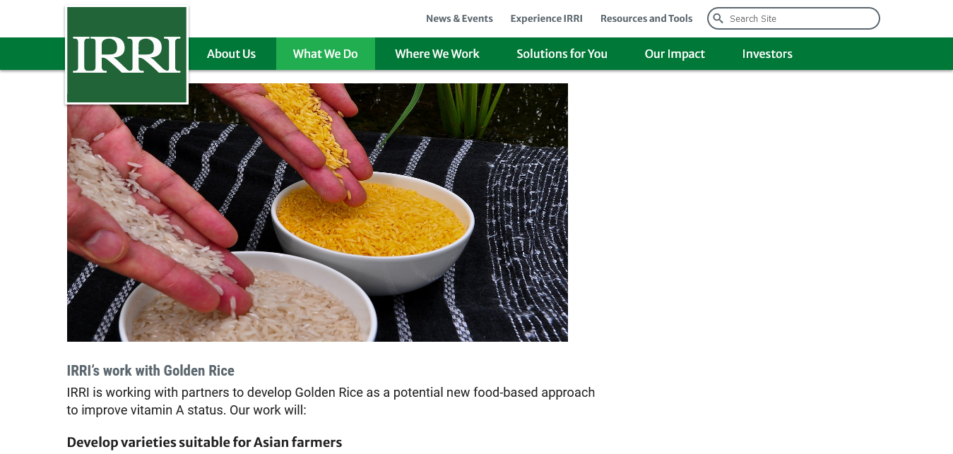

Slide 25
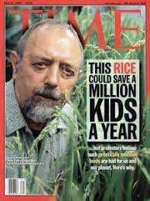
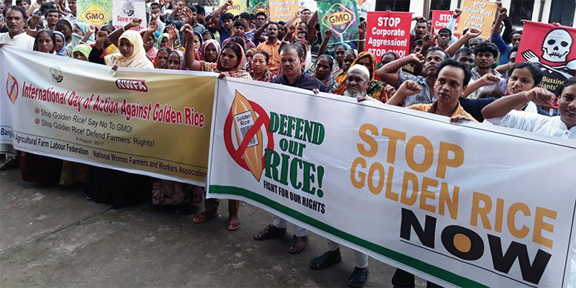

Slide 26
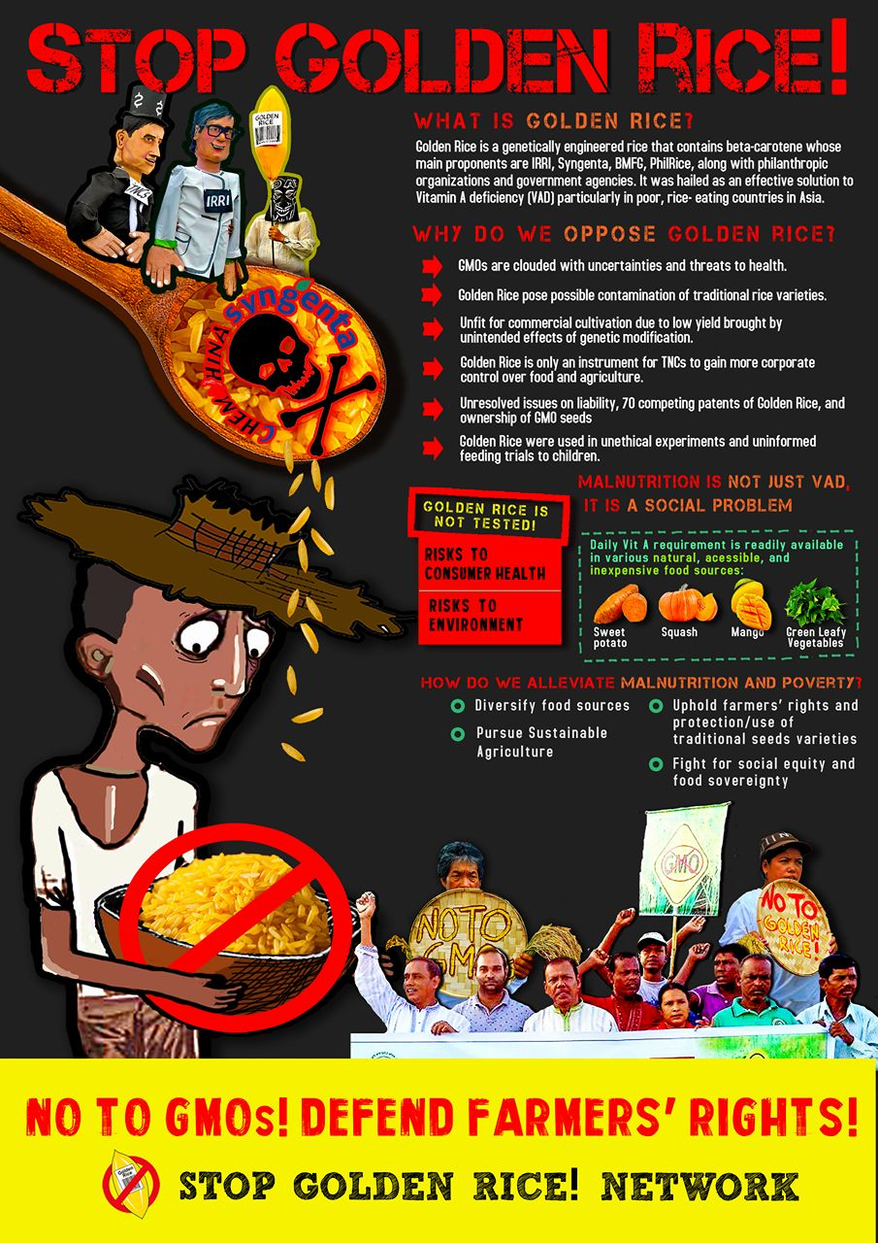

Slide 27
